Slide 1
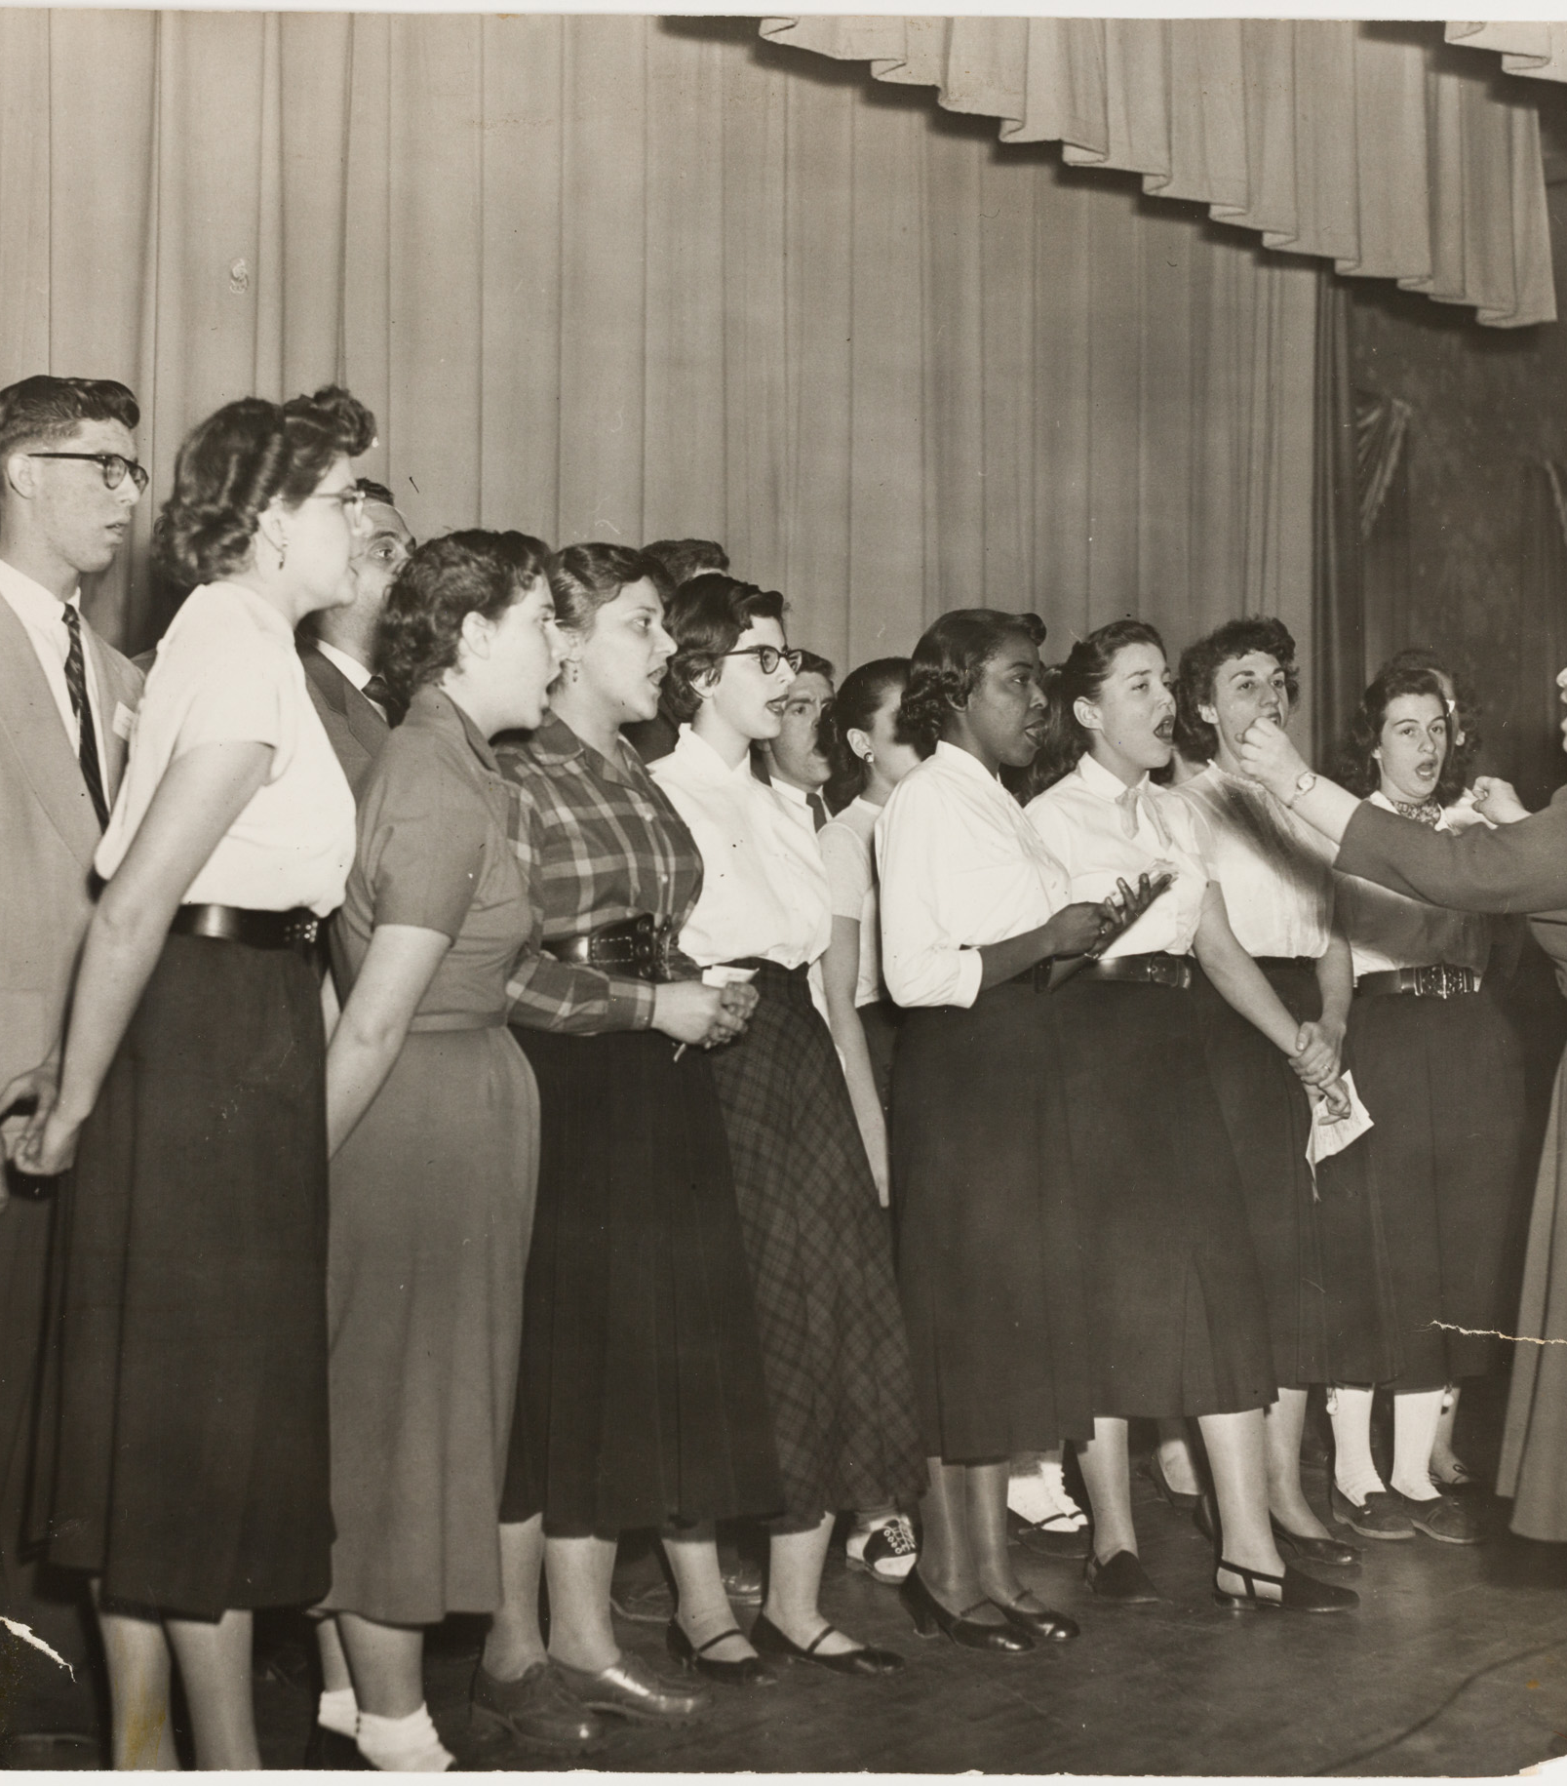
Refuge in the Heights
Private Images from Washington Heights

Slide 2
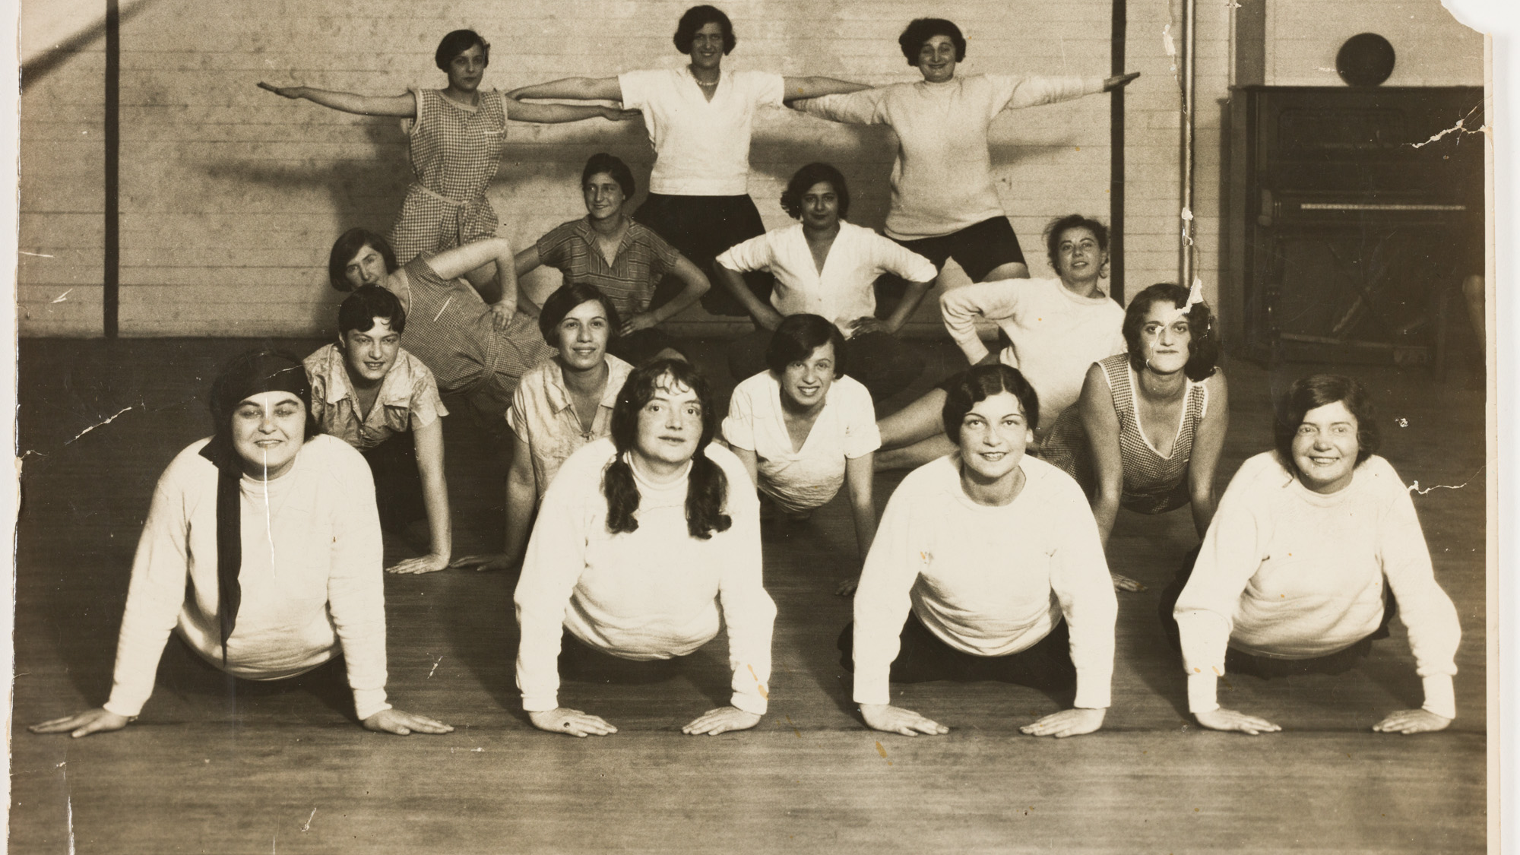
Gymnastic class at the Y, late 1920s
Courtesy the YM & YWHA of Washington Heights and Inwood

Slide 3
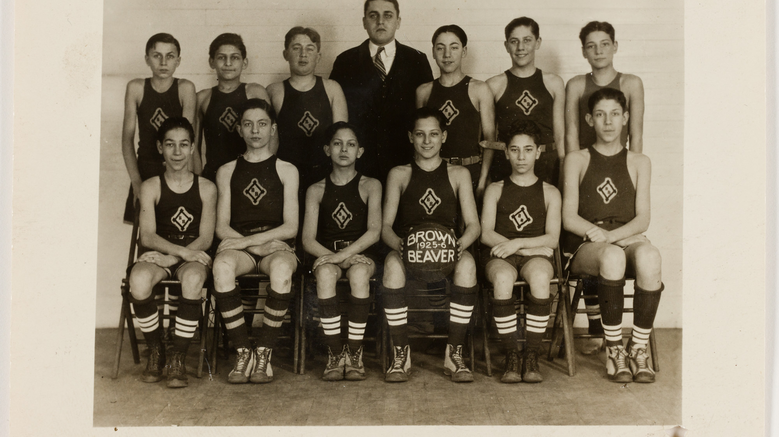
Gymnastic class at the Y, late 1920s
Courtesy the YM & YWHA of Washington Heights and Inwood

Slide 4
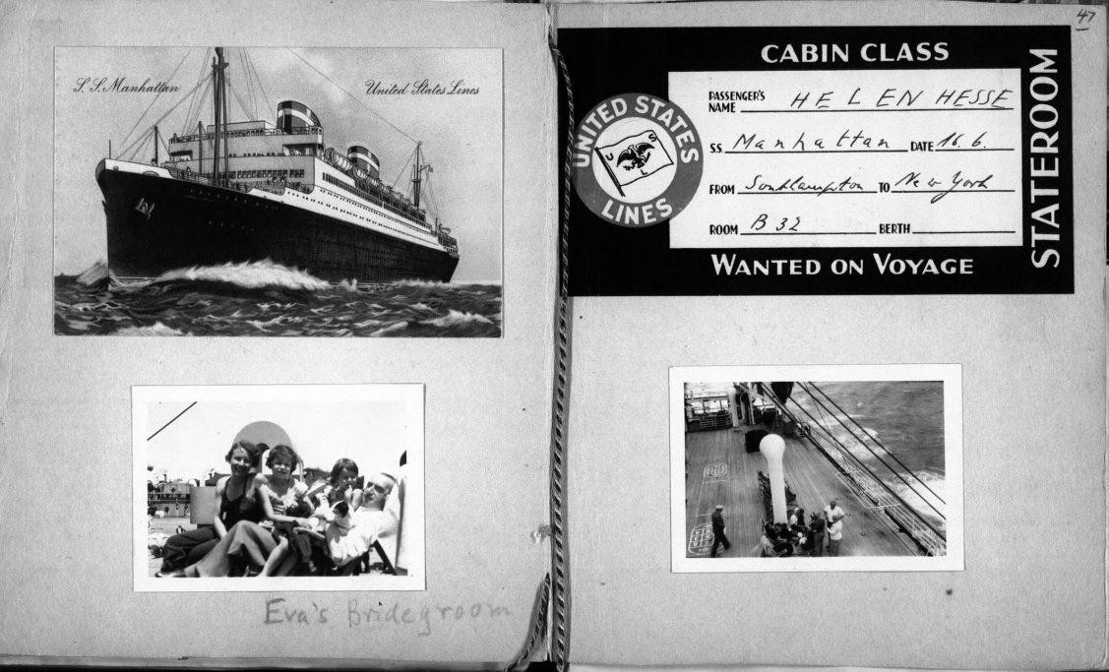
Hesse Family on their way to United States, June 1939.
LBI Archives, Helen & Eva Hesse Collection

Slide 5
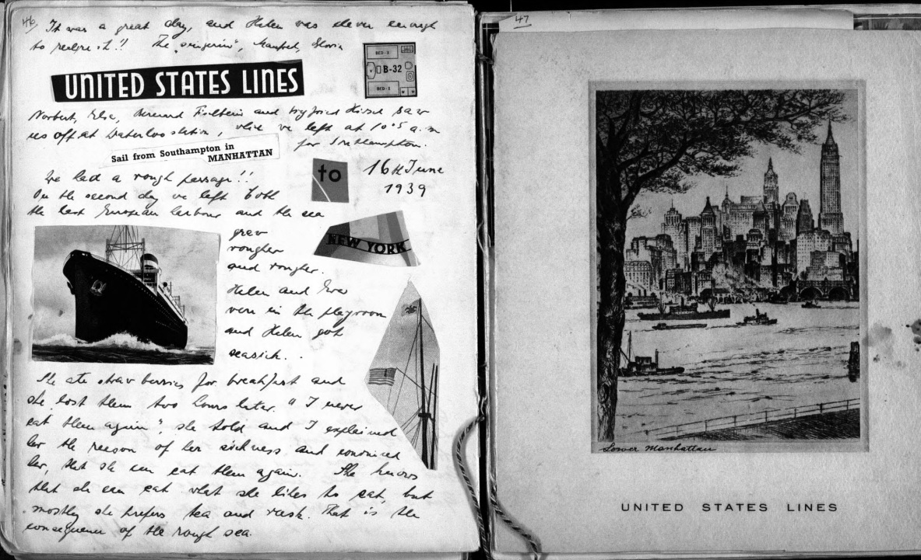
Hesse family’s diary, June 1939.
LBI Archives, Helen & Eva Hesse Collection

Slide 6
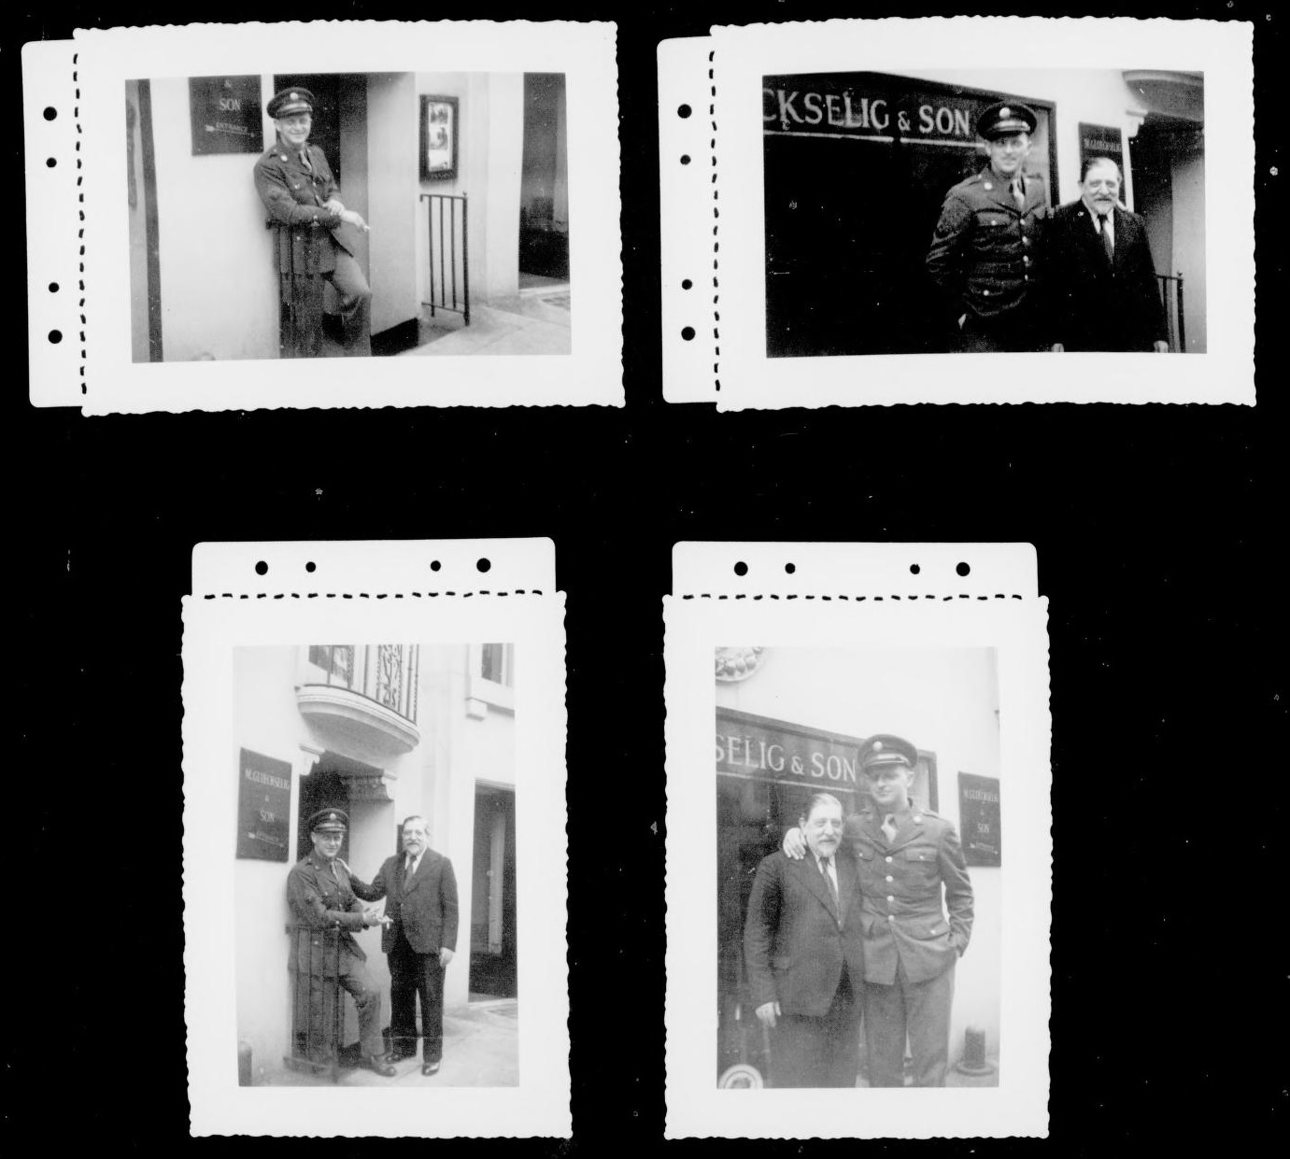
Leo Glueckselig in Army Uniform with his father, 1940s
LBI Archives, Leo Glueckselig Collection

Slide 7
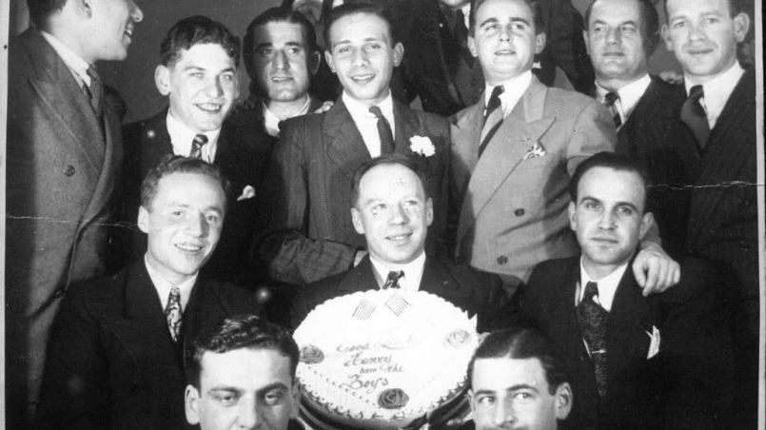
Birthday party of Ludolf Heidecker, 1942
LBI Archives, Heidecker and Schmitt Family Collection

Slide 8
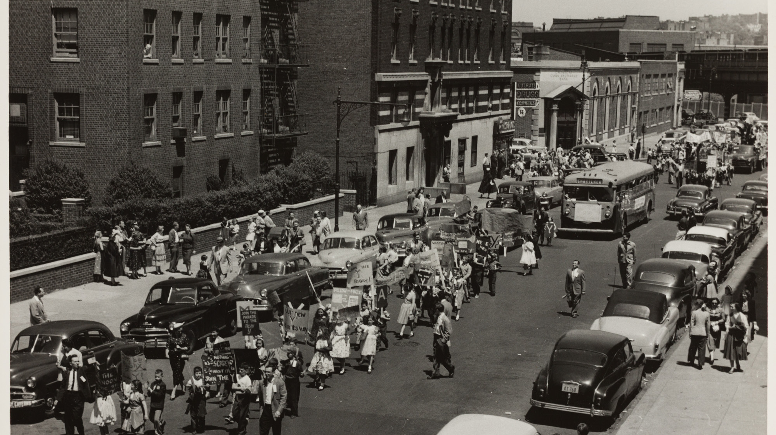
Parade marking the move of the YM & YWHA to its new building, 1956
Courtesy of the YM & YWHA of Washington Heights and Inwood

Slide 9
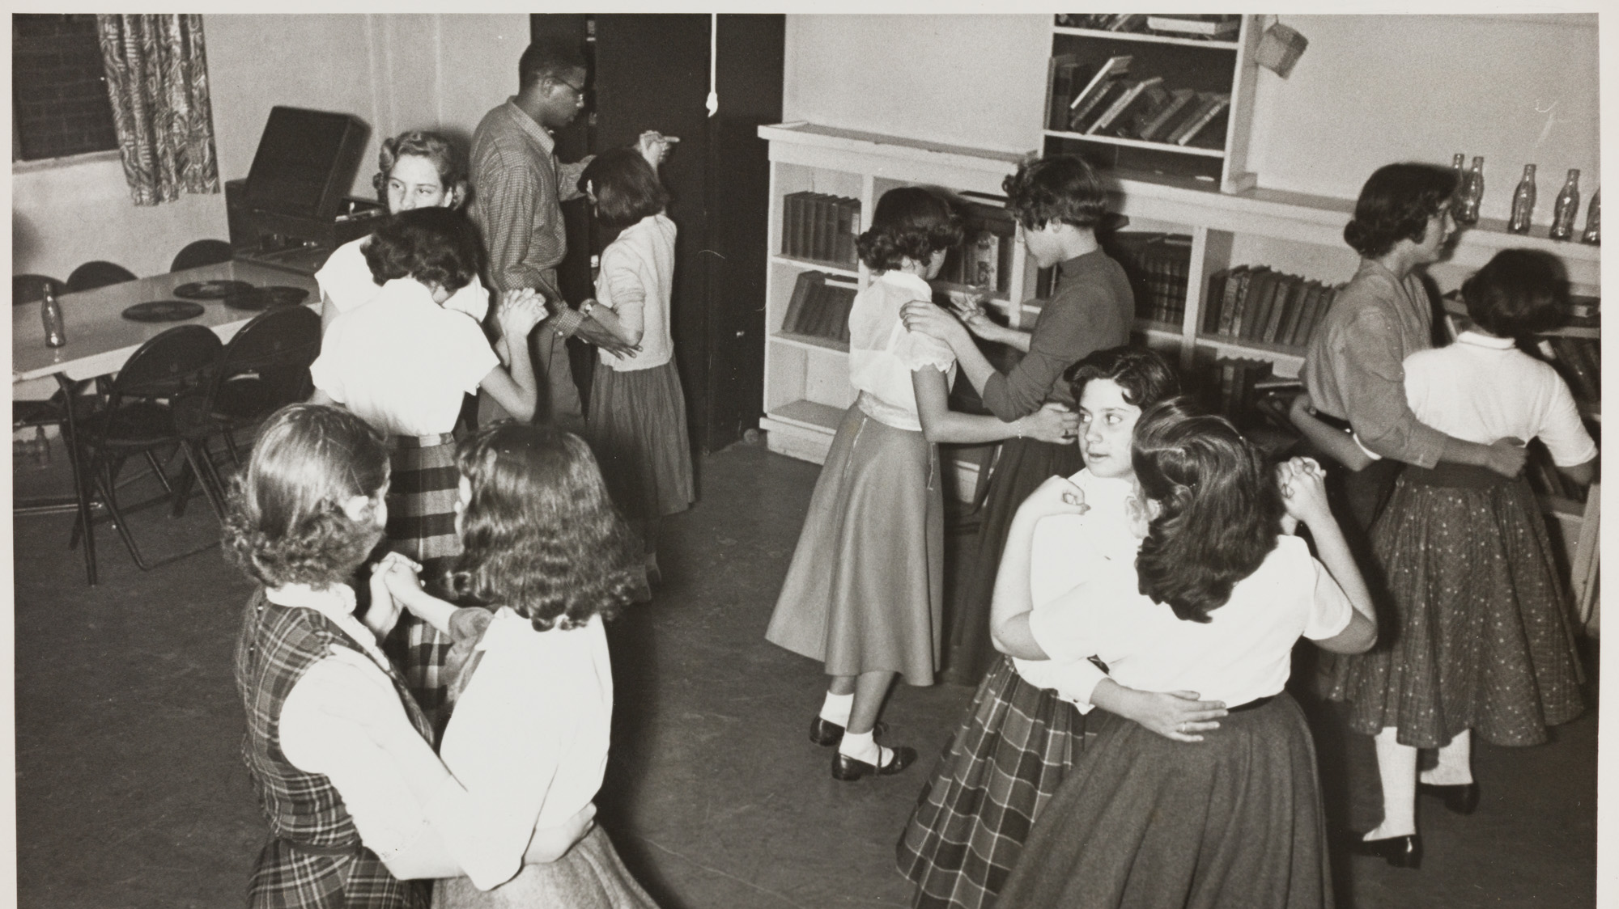
Dancing evening at the Y, 1950s
Courtesy of the YM & YWHA of Washington Heights and Inwood

Slide 10
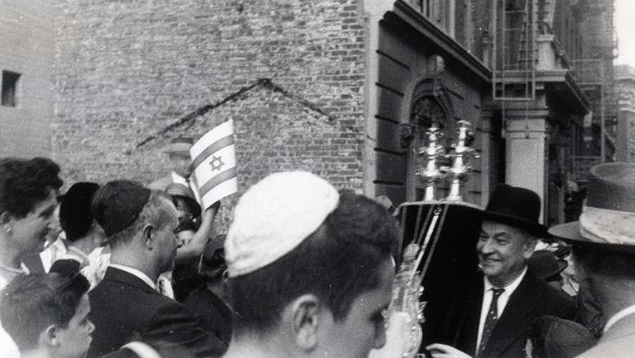
Parading with the Torah scrolls outside congregation Shaaret Hatikvah, 1940
LBI Archives, Kurt Goldschmidt Collection

Slide 11
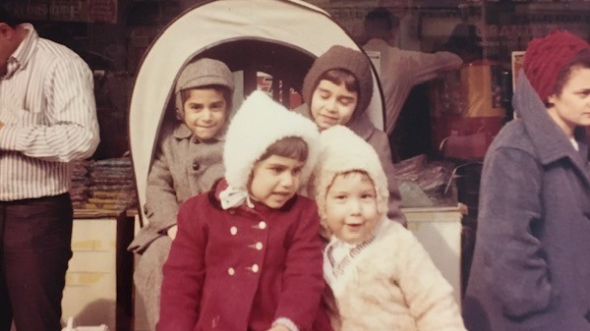
The Rigas Children playing in front
of the Wertheimer Department Store
in Washington Heights, at 181st St
between Wadsworth and St. Nicholas
Avenue
Courtesy of the Children of the Rigas Family

Slide 12
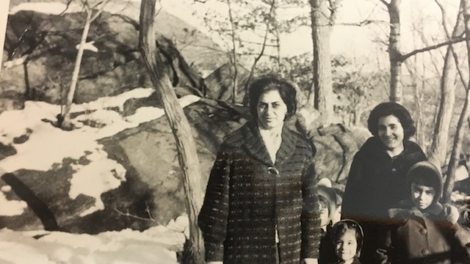
Courtesy of the Children of the Rigas Family

Slide 13
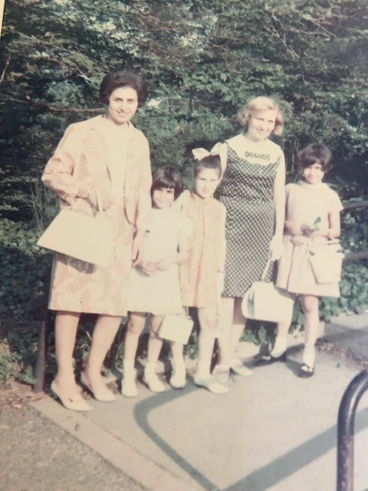
Courtesy of the Children of
The Rigas Family

Slide 14
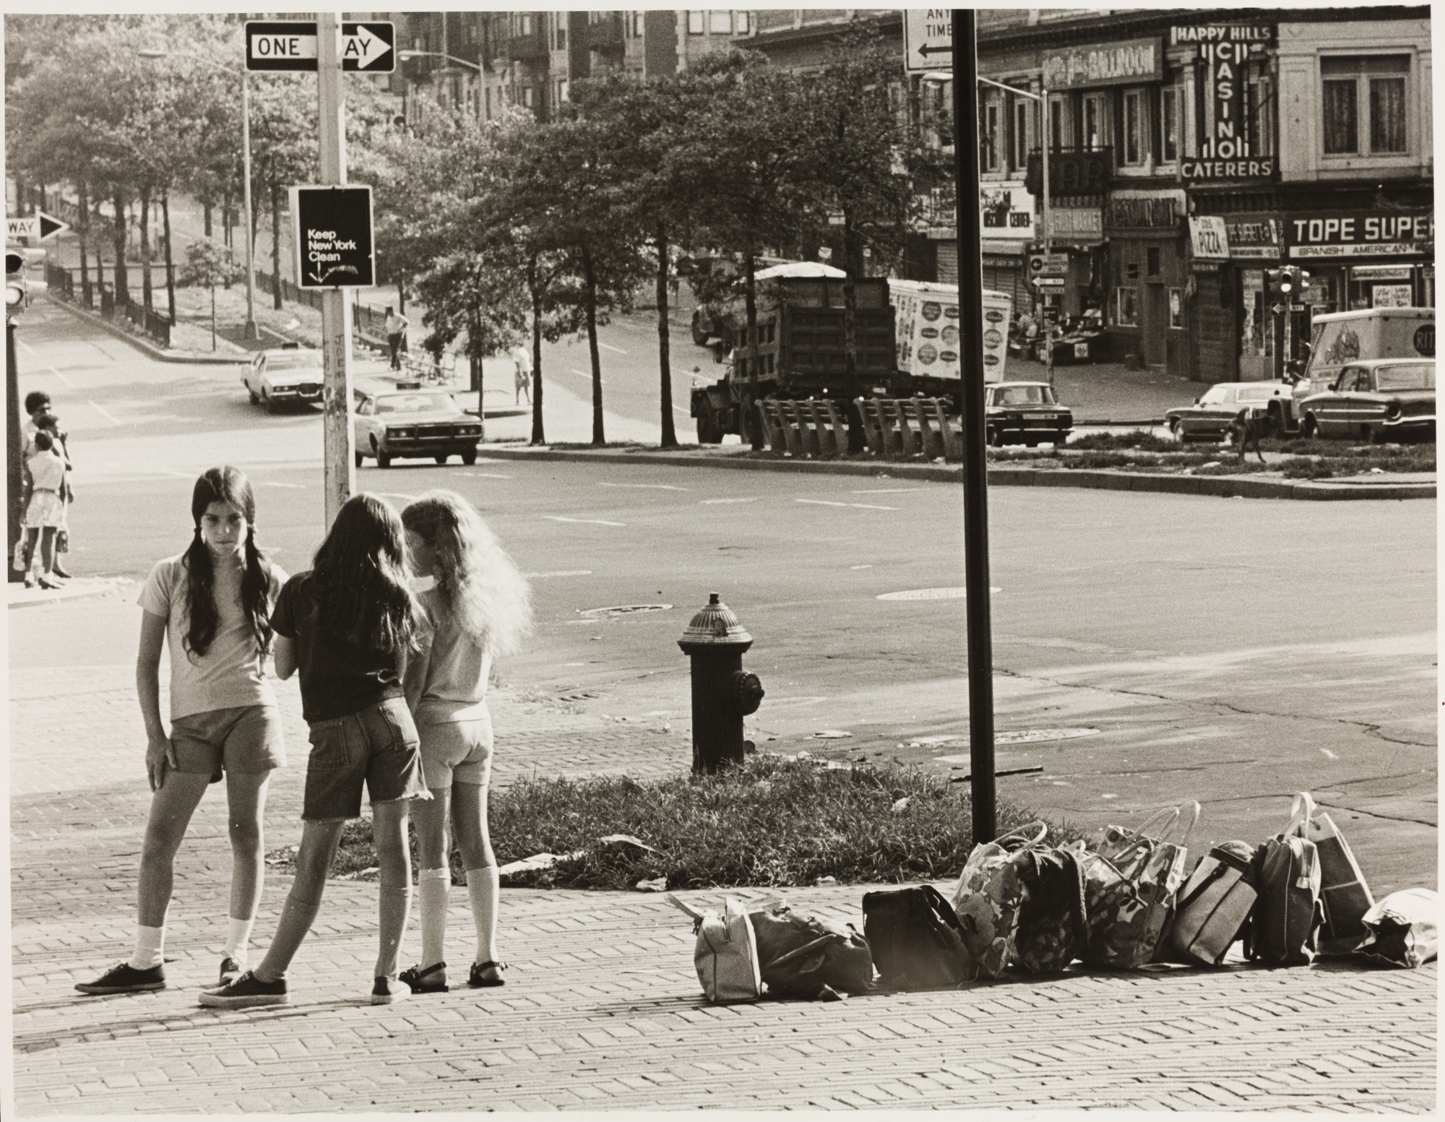
Summer camp of the Y, 1970s
Courtesy of the YM & YWHA of Washington Heights and Inwood

Slide 15
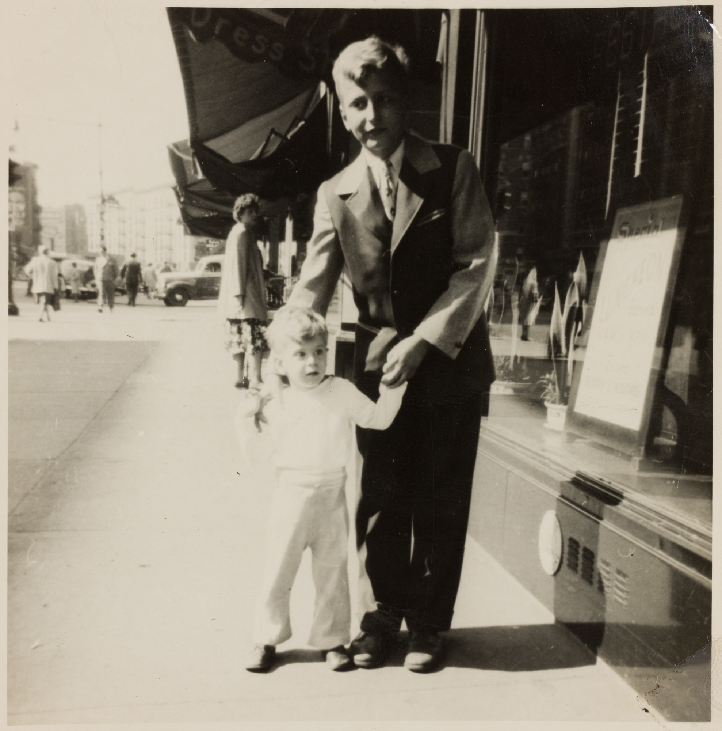
Members of Peter Ellis Family
Courtesy of Peter Ellis Family

Slide 16
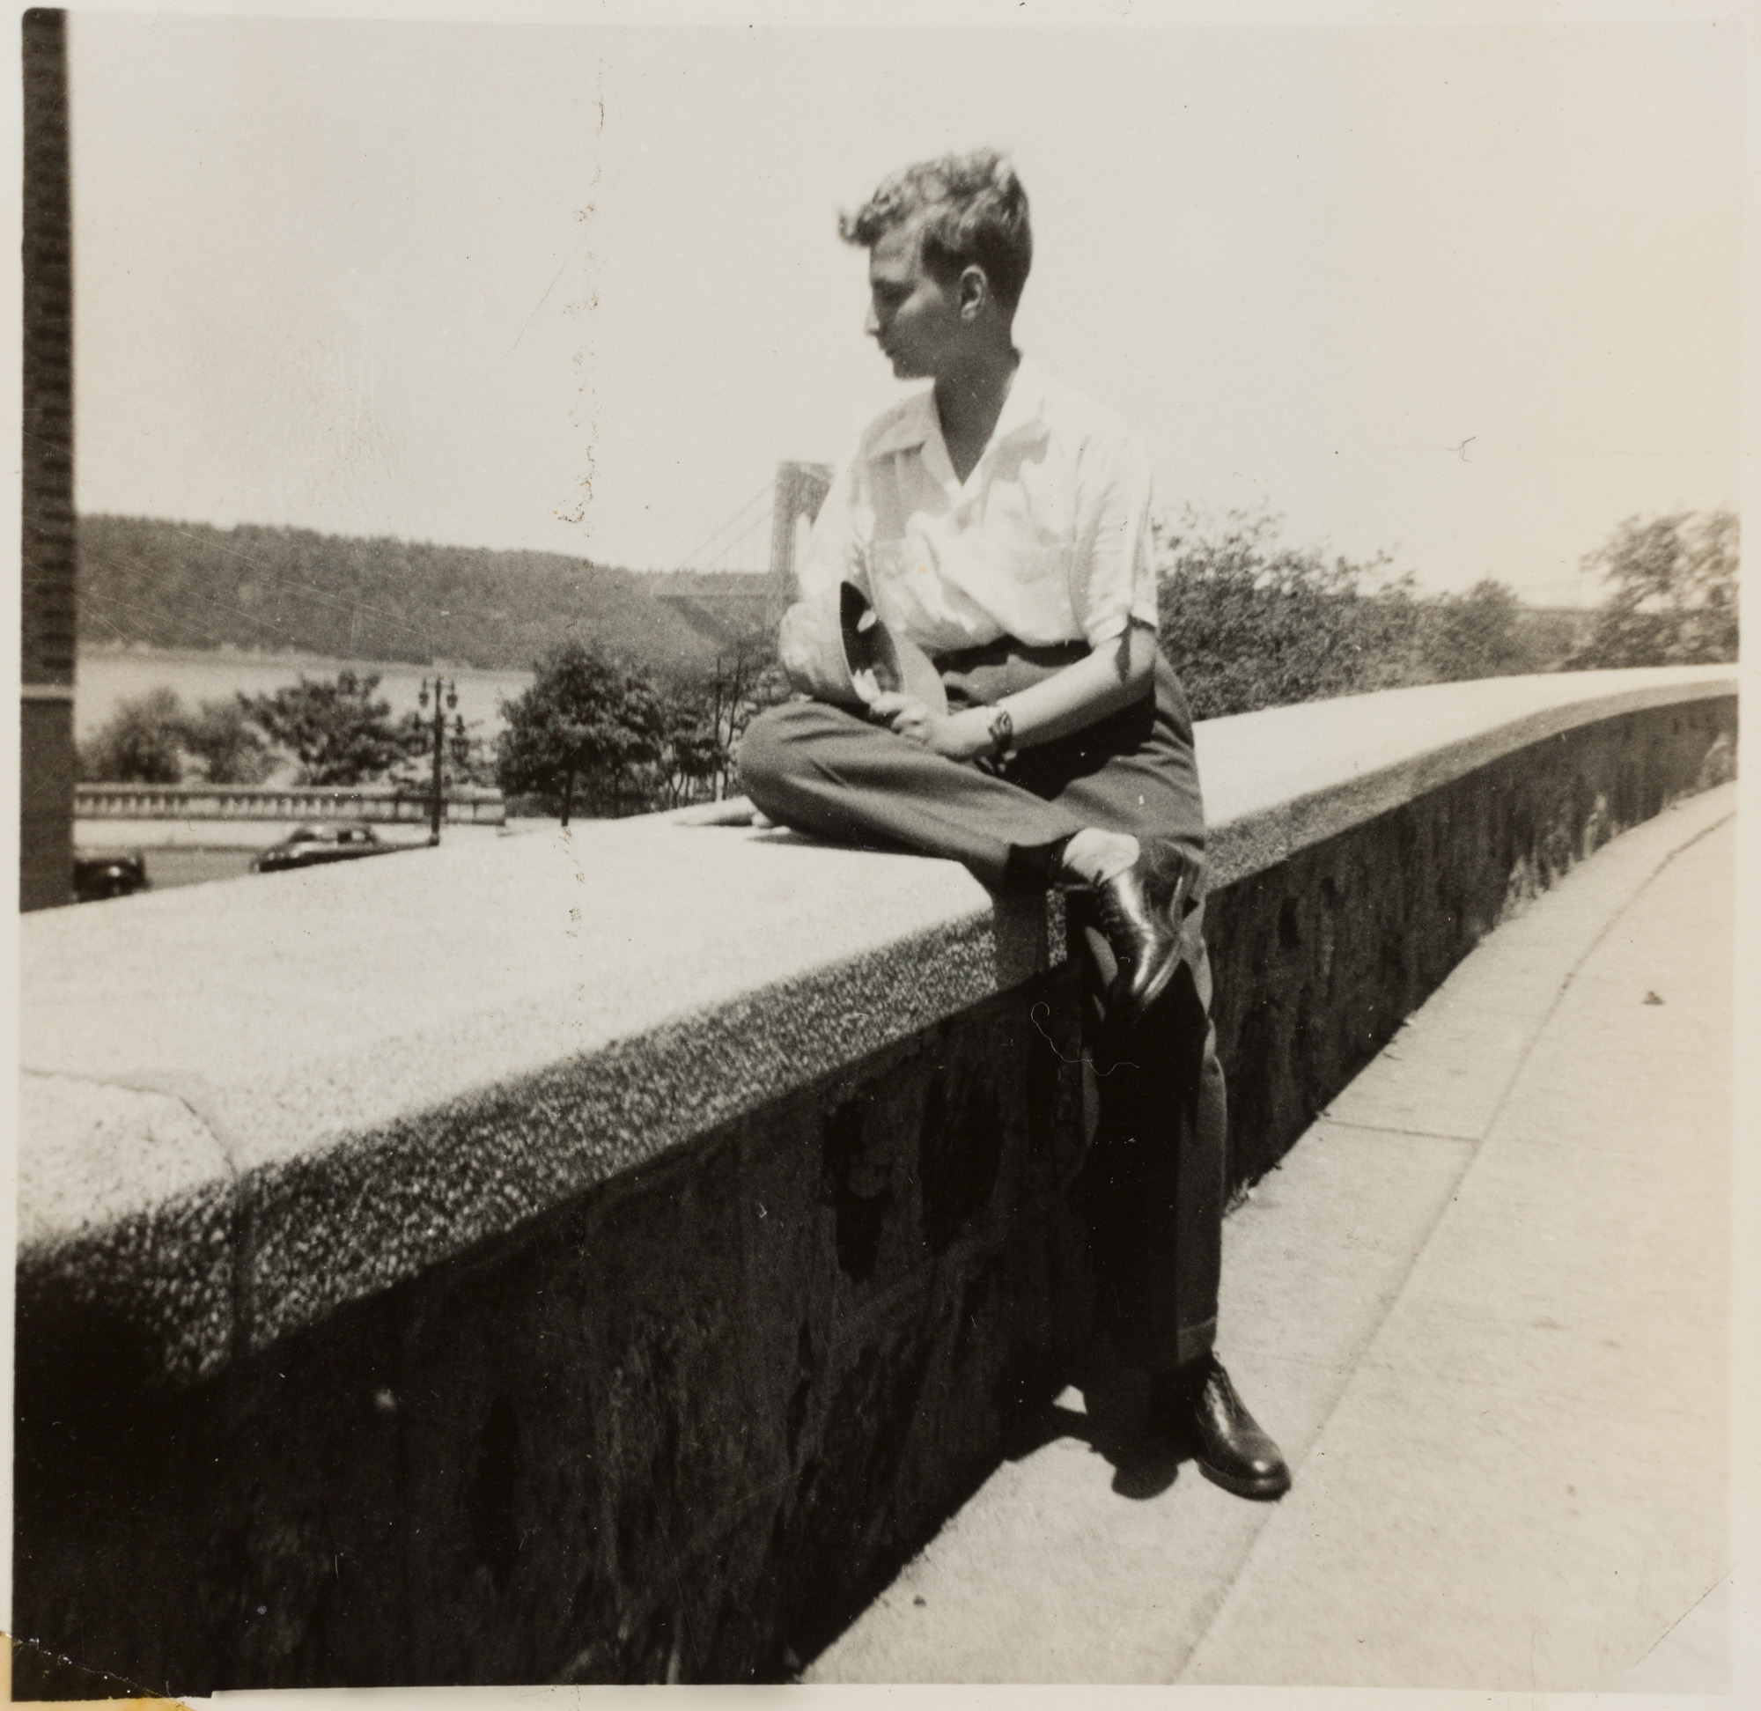
Members of Peter Ellis Family
Courtesy of Peter Ellis Family

Slide 17
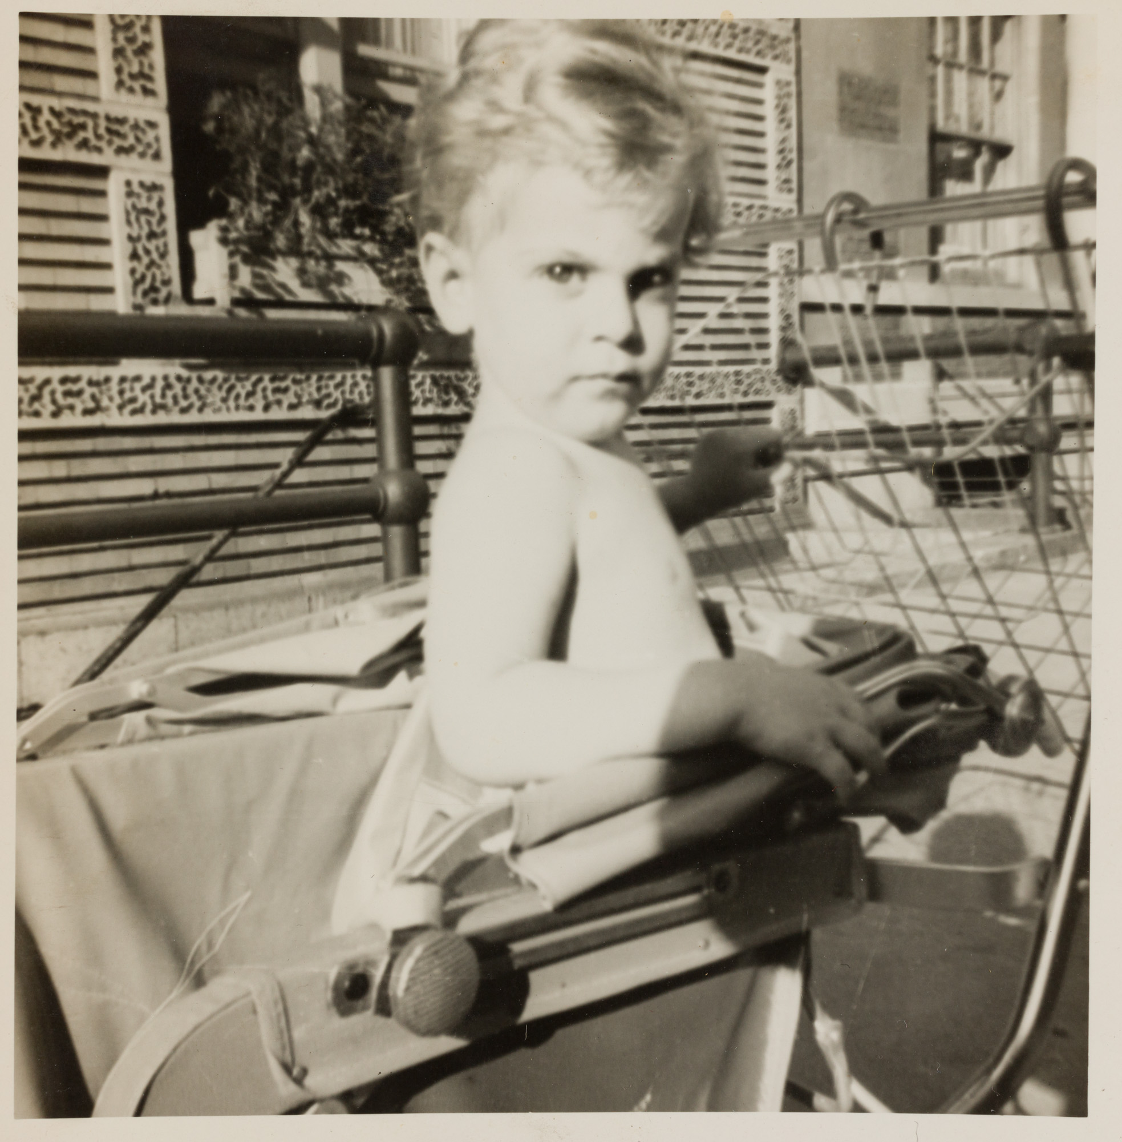
Member of Peter Ellis Family
Courtesy of Peter Ellis Family

Slide 18
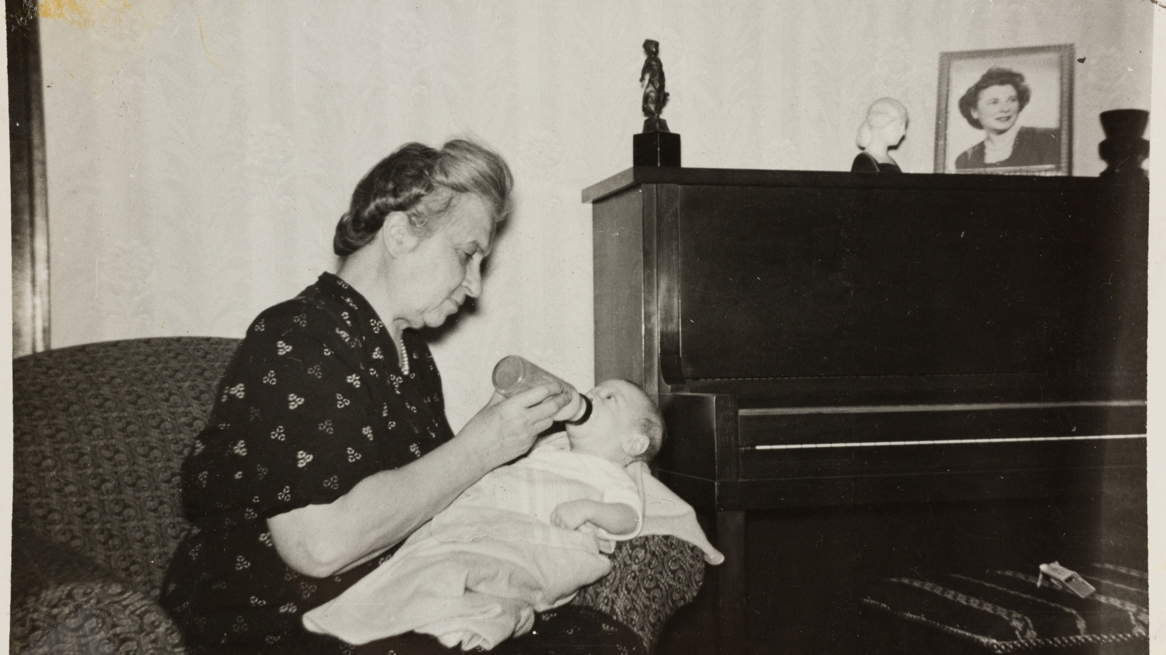
Members of Peter Ellis Family
Courtesy of Peter Ellis Family

Slide 19
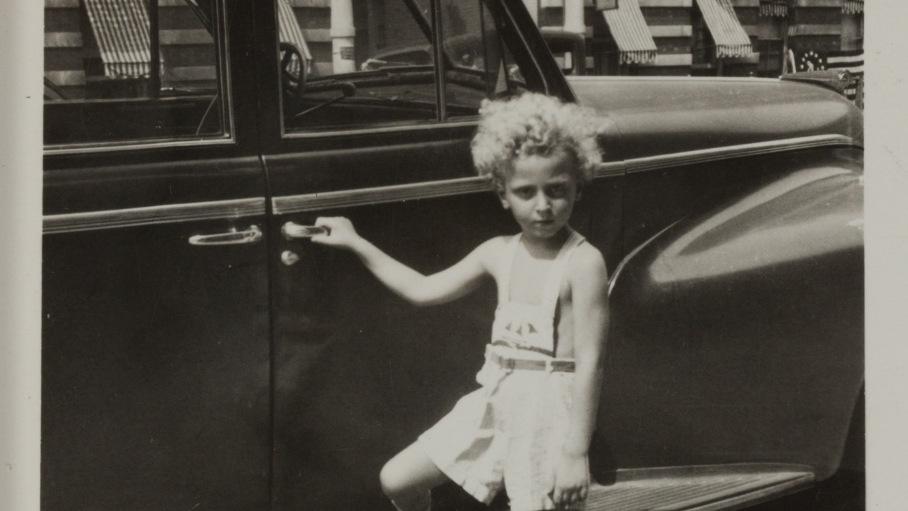
Members of Peter Ellis Family
Courtesy of Peter Ellis Family

Slide 20
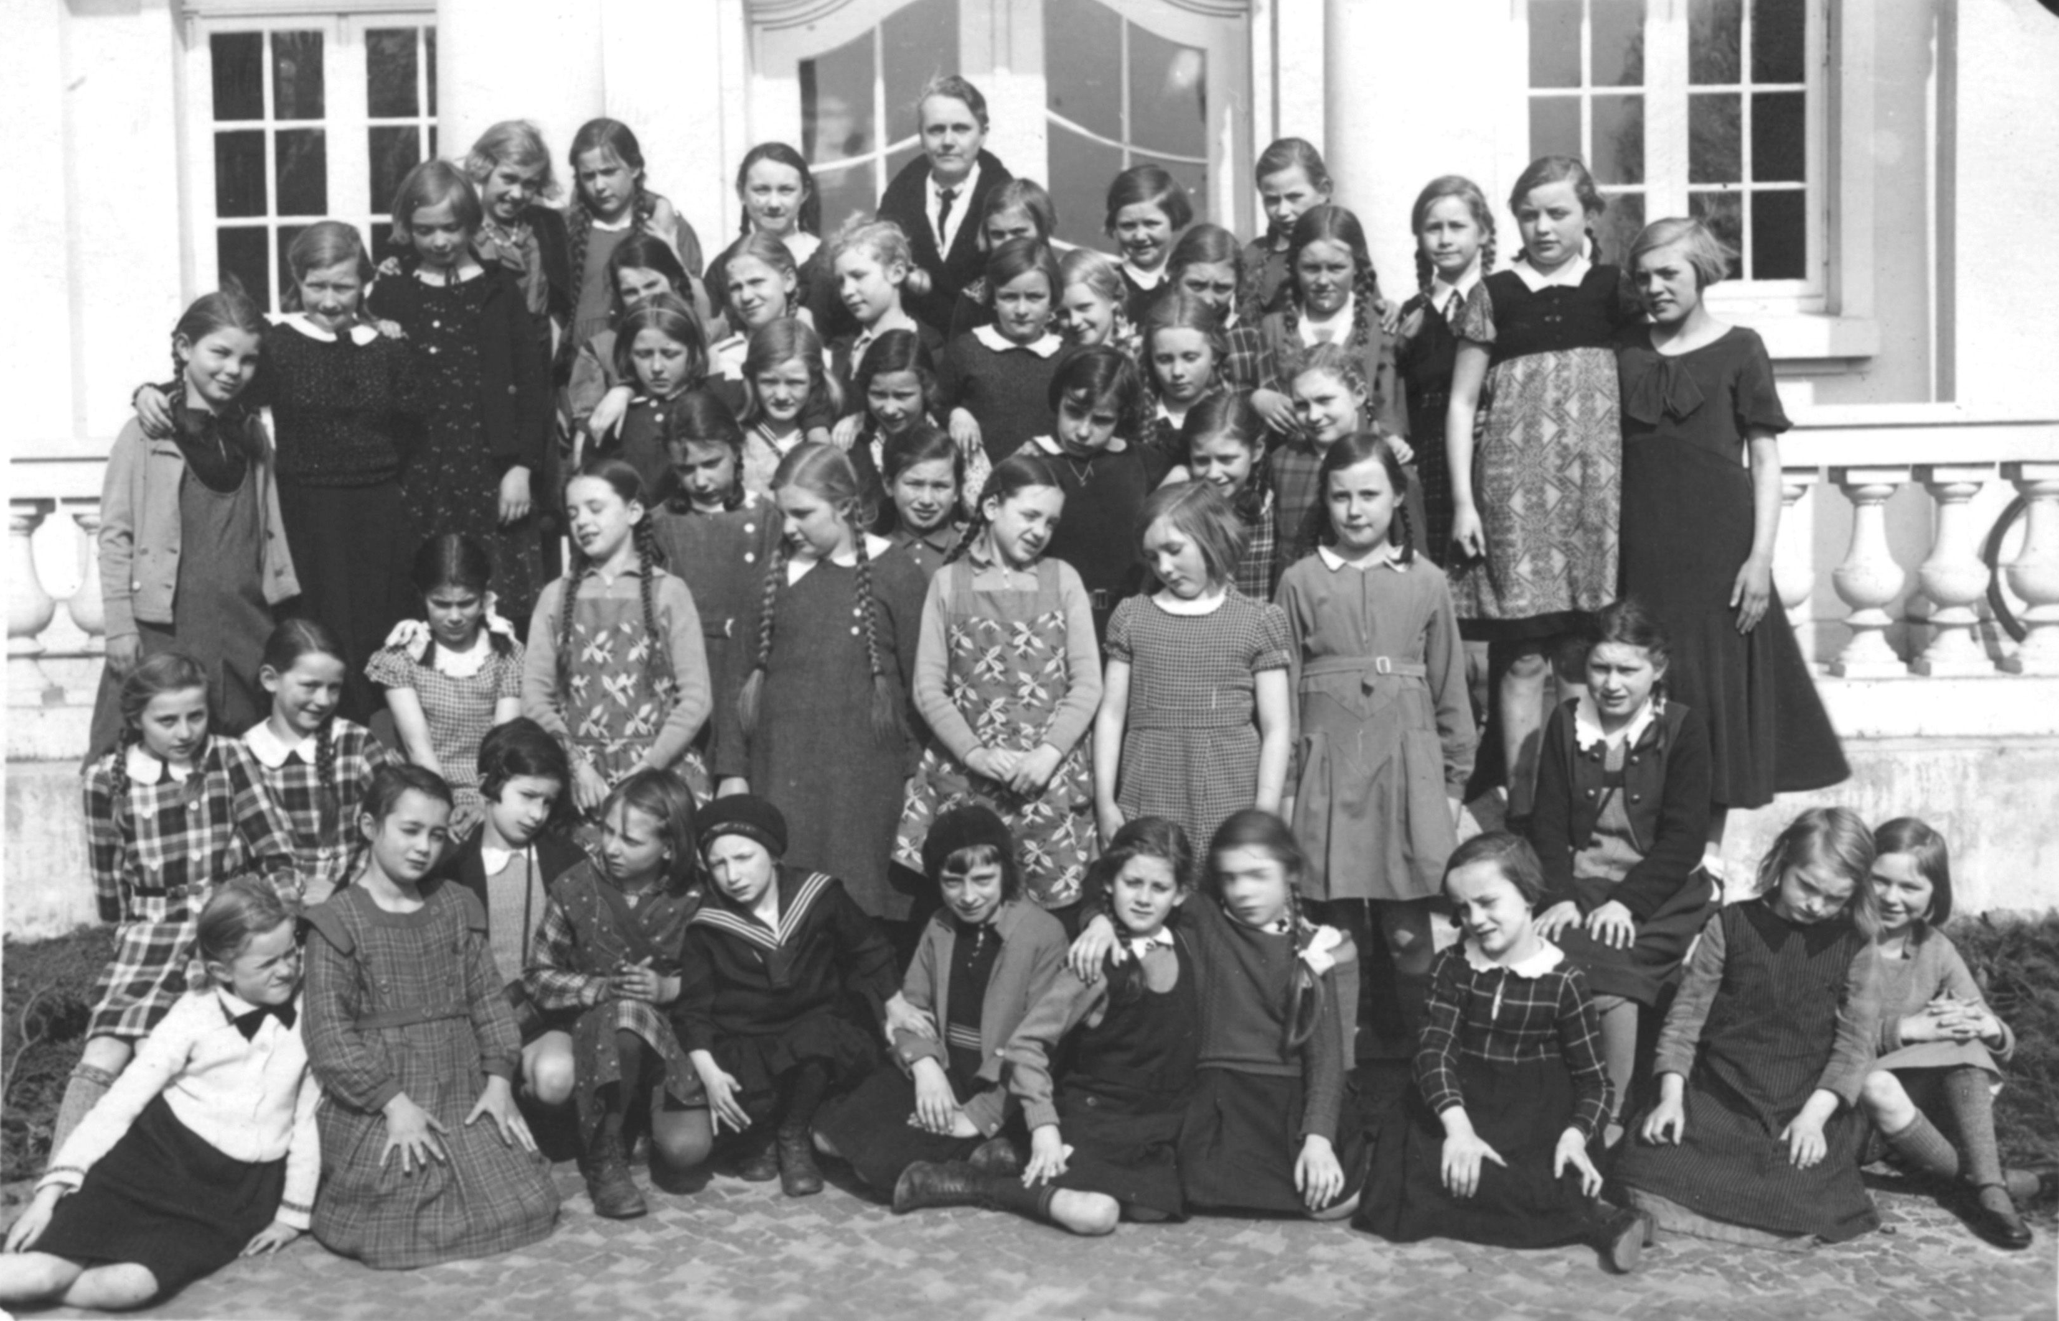
Edith Schickler, later Edith Rosenbaum, (3rd from the left, bottom row), Luneburg, 1934. The family immigrated to Washington Heights, where Edith learned English. She later taught English in the same high school to a new generation of immigrants.
Courtesy of Susan Rosenbaum Greenberg

Slide 21
Edith Rosenbaum with her students, George Washington High School
Courtesy of Susan Rosenbaum Greenberg

Slide 22
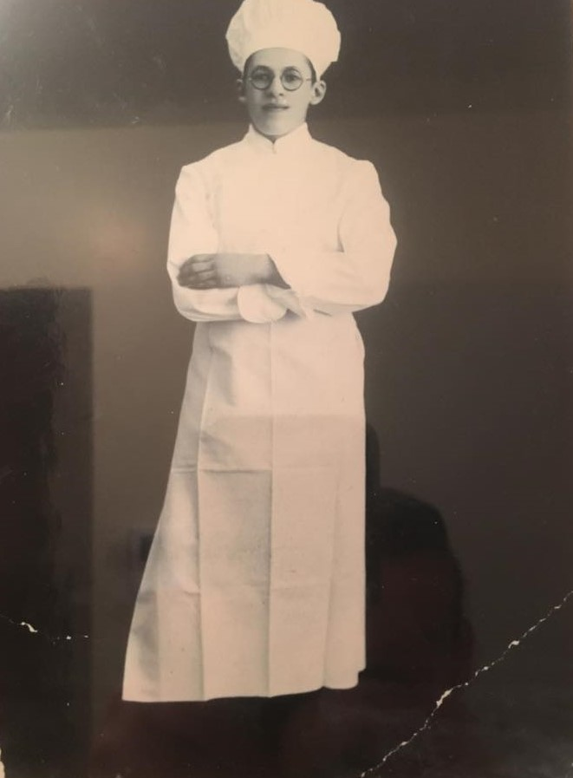
The late Mr. Willi Gruenebaum (1911-1993) inherited his father’s bakery in Frankfurt am Main.
After leaving Nazi Germany and arriving in NY he worked for several other bakeries. In 1956 he re-established his company under several names. Today, the company still exists in a much smaller capacity, but a legacy continues as it is now operated by the 4th generation of the Gruenebaum family.
Courtesy of Jonathan E. Gruenebaum

Slide 23
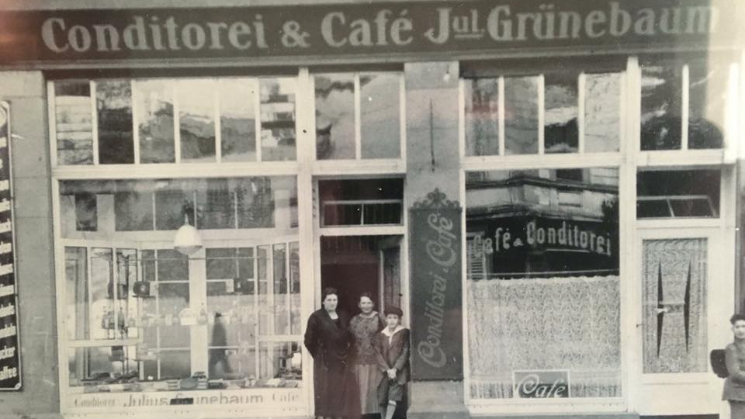
Courtesy of Jonathan E. Gruenebaum

Slide 24
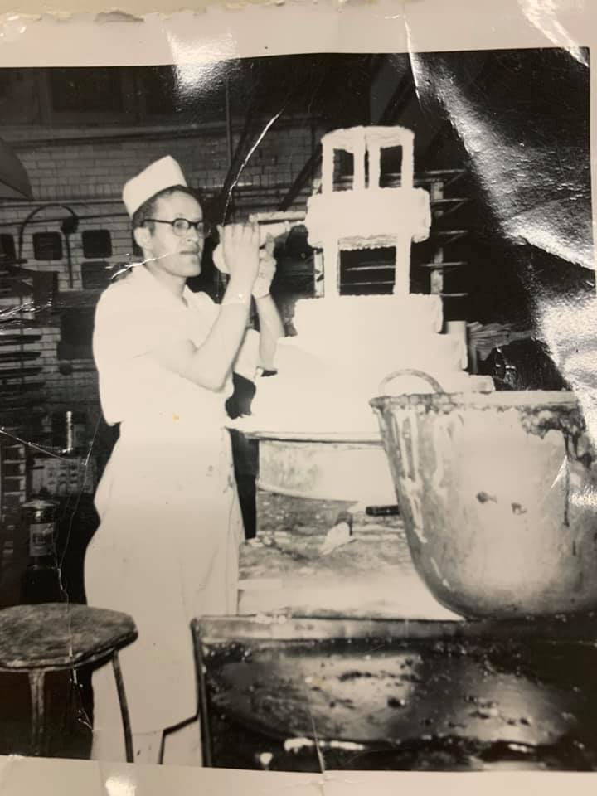
Courtesy of Jonathan E. Gruenebaum

Slide 25
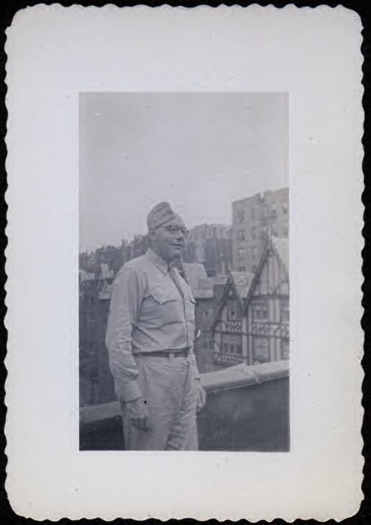
Portrait of Berthold Werner
in military uniform,
Washington Heights, 1943.
LBI Archives, Martha Werner Collection

Slide 26
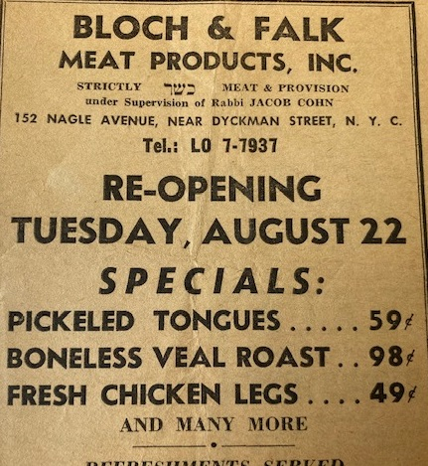
Bloch and Falk Meat Products, Inc.
Courtesy of Herta Bloch

Slide 27
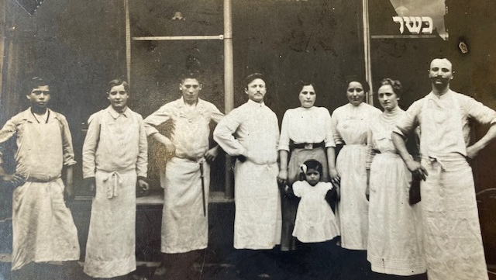
The Bloch and Falk families in Frankfurt at their family butcher business, 1913
Courtesy of Herta Bloch

Slide 28
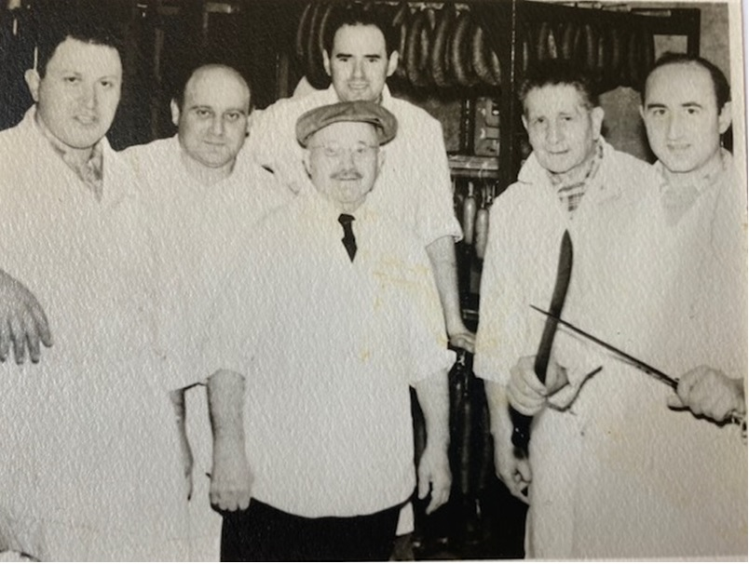
Bloch & Falk kosher meat store at the corner of Broadway and 173rd Street, 1940s
Courtesy of Herta Bloch

Slide 29
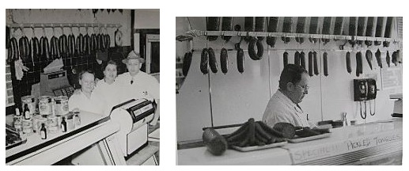
Bloch & Falk kosher meat store, 1940s
Courtesy of Herta Bloch

Slide 30
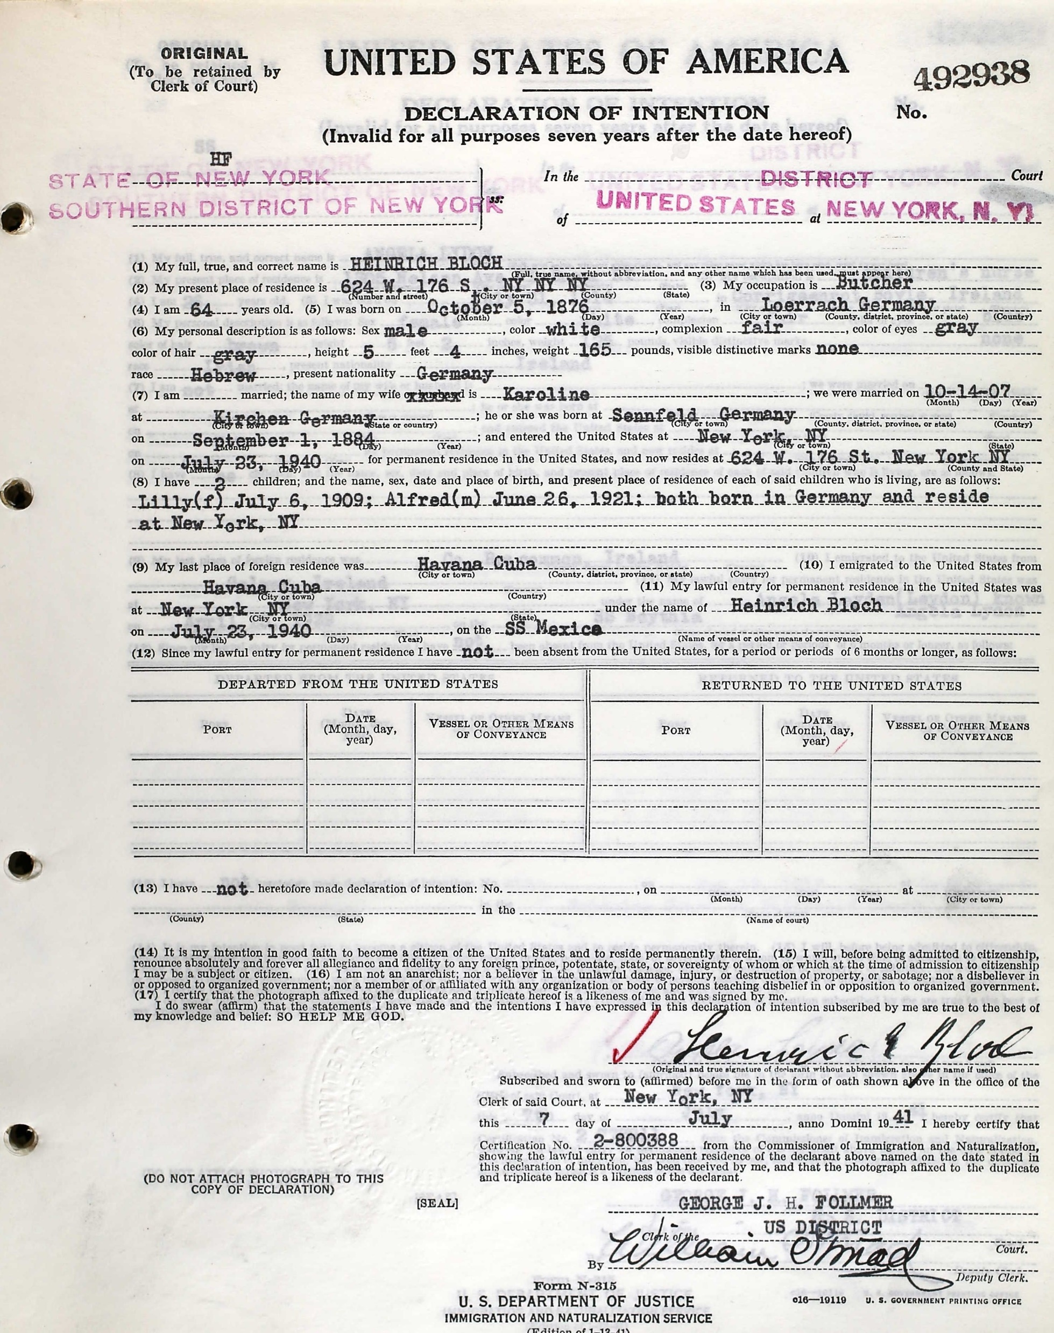
Immigration documents
for Heinrich Bloch, 1941
Courtesy of Herta Bloch

Slide 31
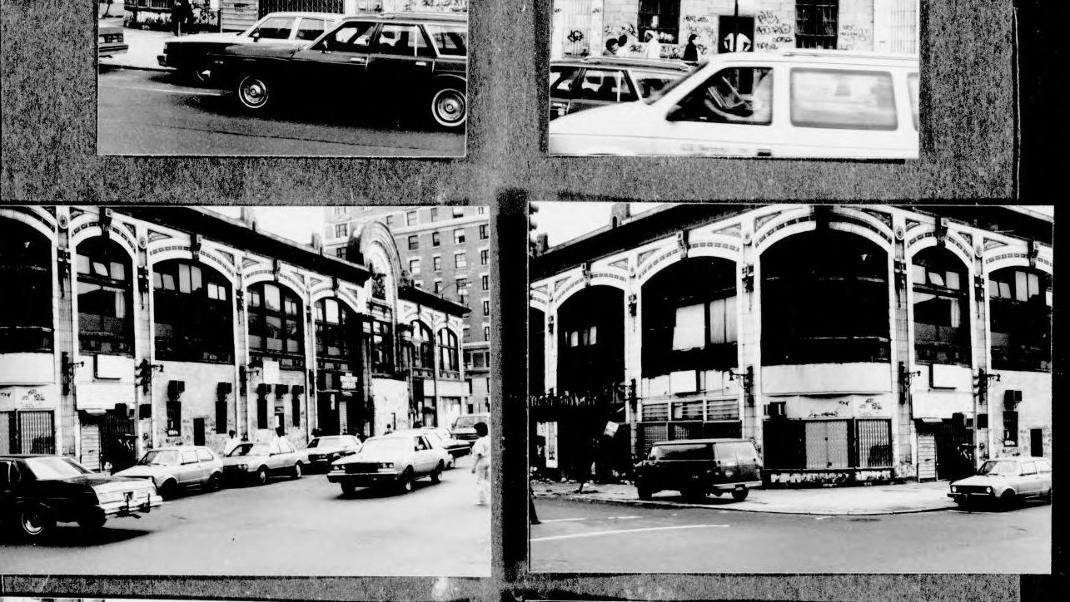
Audubon Ballroom, 1970s
LBI Archives, Leo Glueckselig Collection

